Slide 1






DI GI TAL SI GNAL PROCESSI NG
OPTI CAL CHARACTER RECOGNI TI ON

Slide 2
OBJECTIVE
To recognise the characters from an image handwritten or
printed text into machine-encoded text.
OCR can be used for Document Digitization, Accessibility for Visually Impaired, License Plate Recognition, Check Processing, Identity Verification, etc.
INTRODUCTION
Optical Character Recognition (OCR) is the type of annotation that allows the transcription of images of typed or handwritten messages into machine- recognizable text.

Slide 3



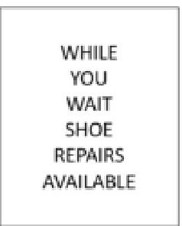

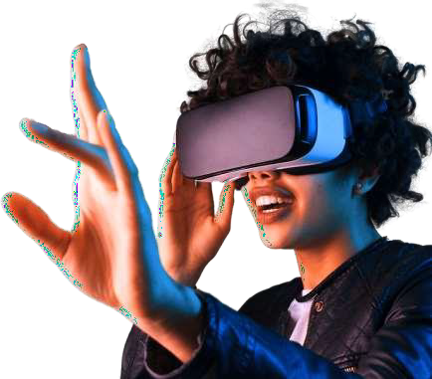
SOFTWARE REQUIRED: MATLAB
OCR
INPUT
THE IMAGE
TO RECOGNISE
TEXT FROM
To perform optical character recognition (OCR) using Python, we can use the Tesseract OCR library.
OUTPUT
THE RECOGNISED
TEXT

Slide 4
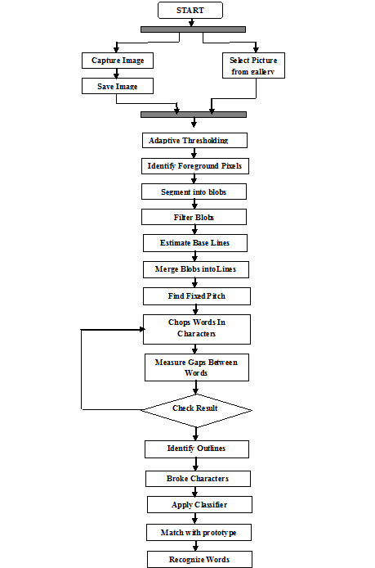
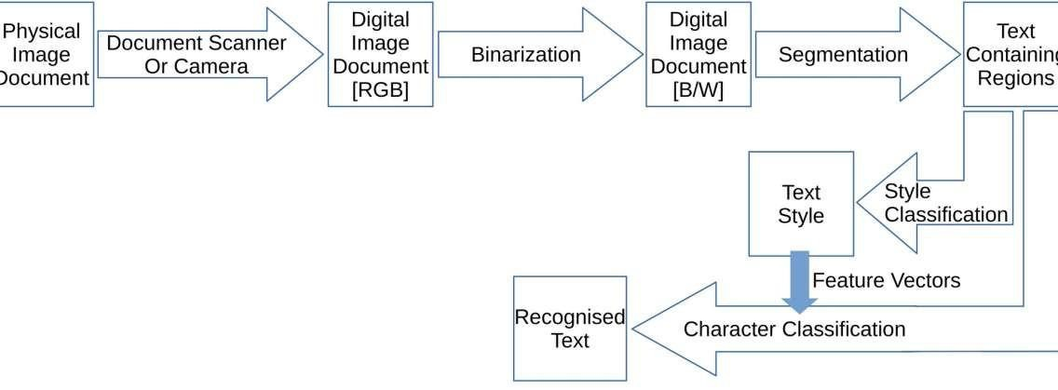

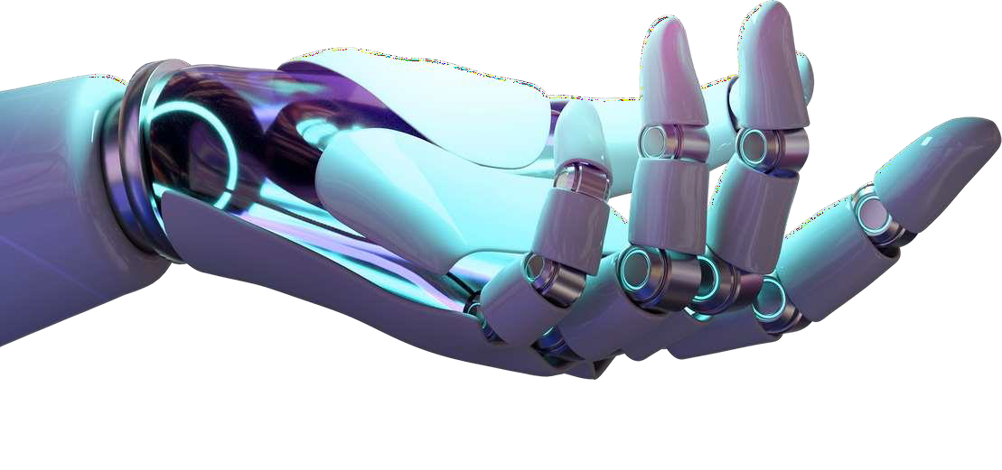
FLOW CHART
BLOCK DIAGRAM

Slide 5
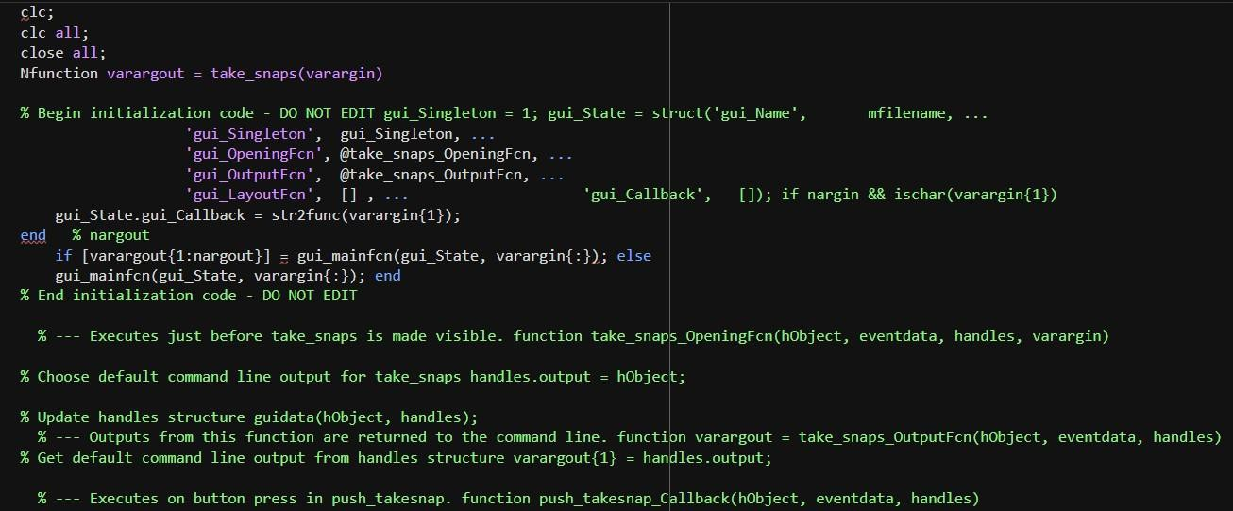
CODE:

Slide 6
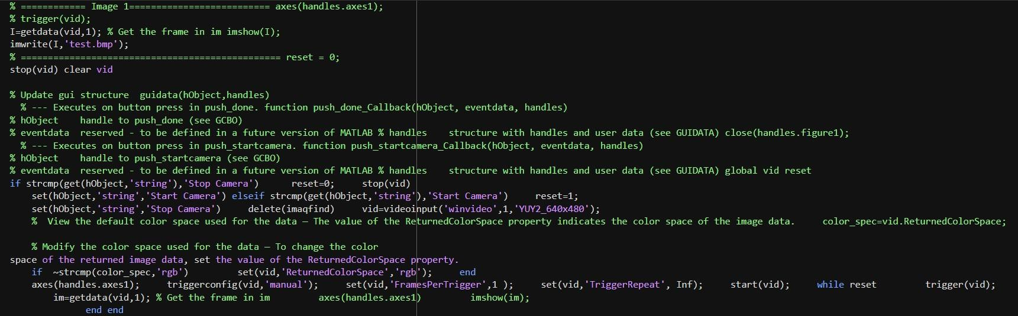

Slide 7
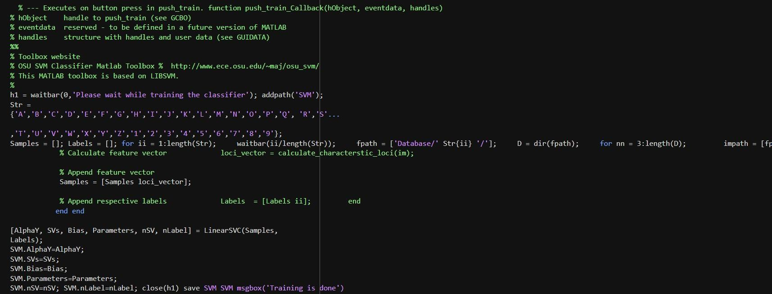

Slide 8
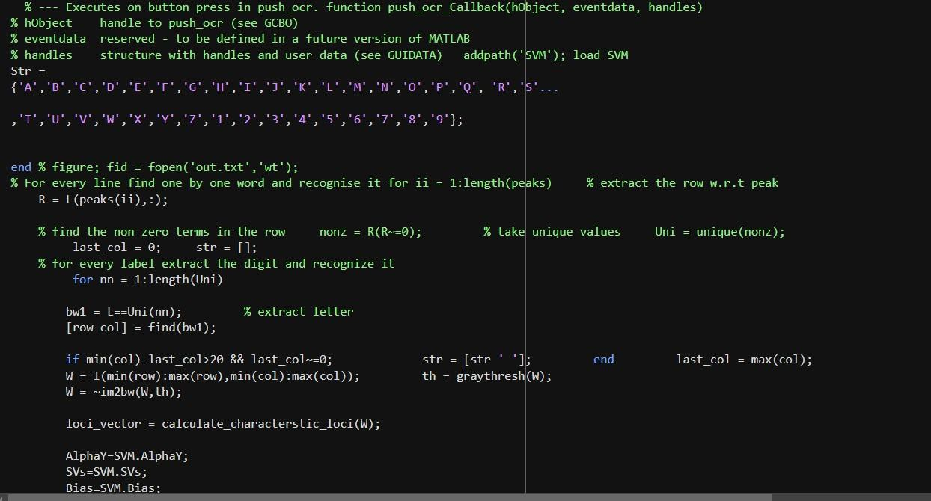

Slide 9
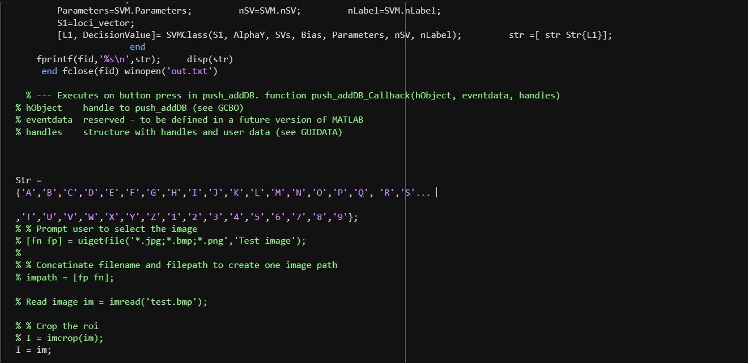

Slide 10
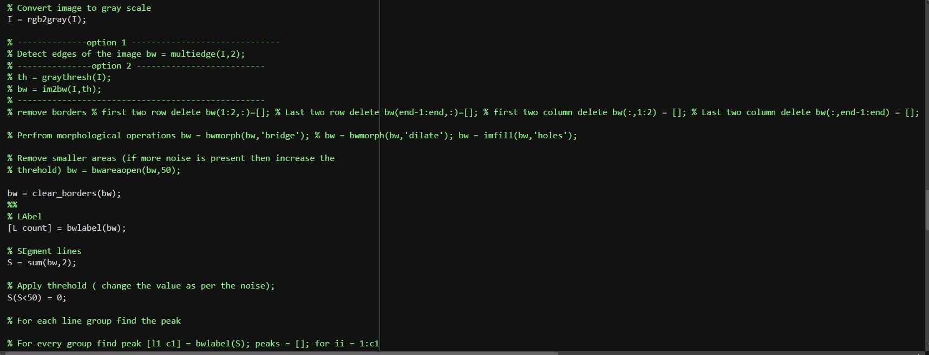

Slide 11
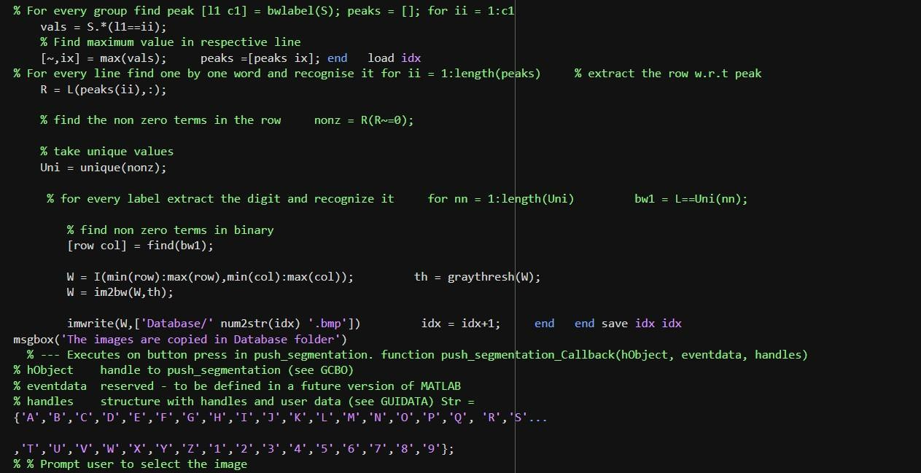

Slide 12
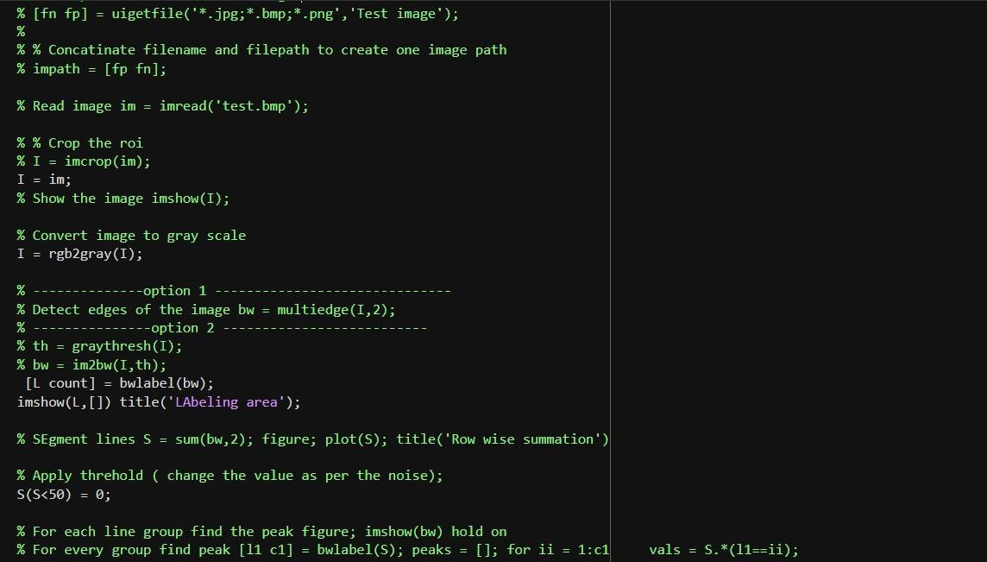

Slide 13
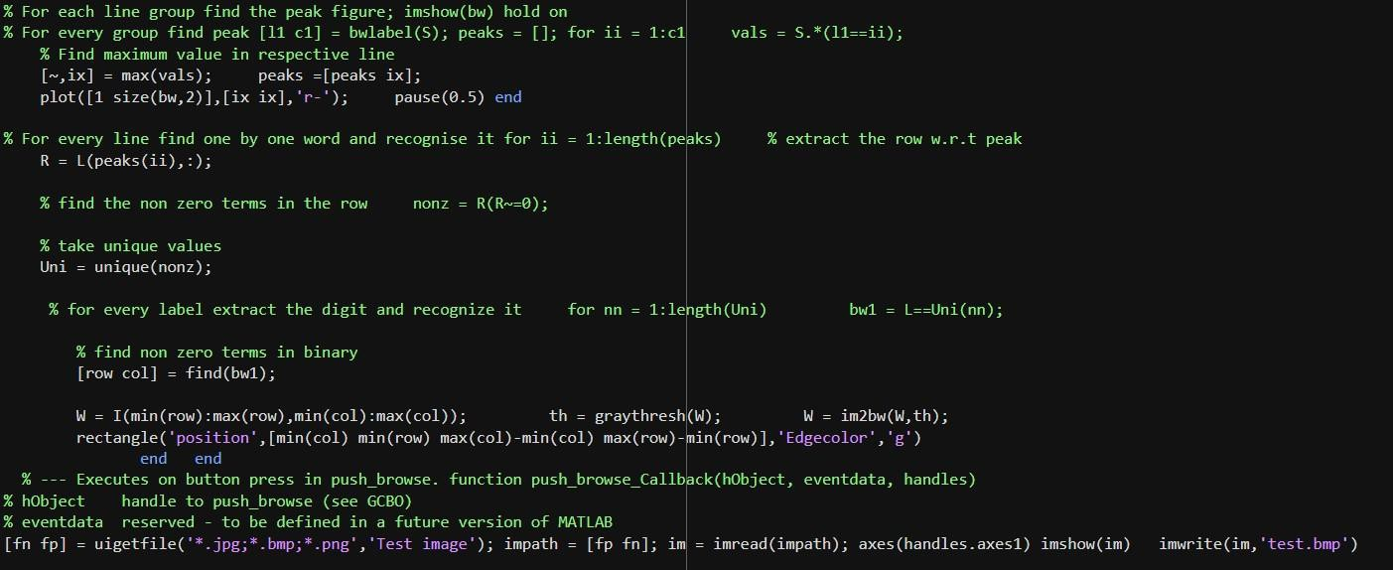

Slide 14
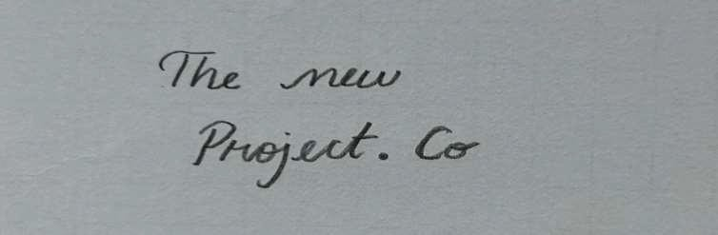
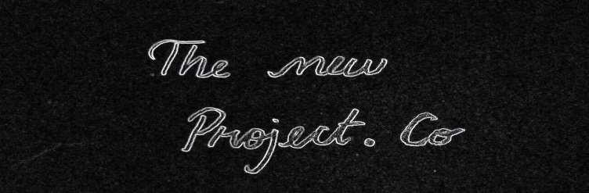
Output:
TEST SAMPLE:
EDGE DETECTION:

Slide 15
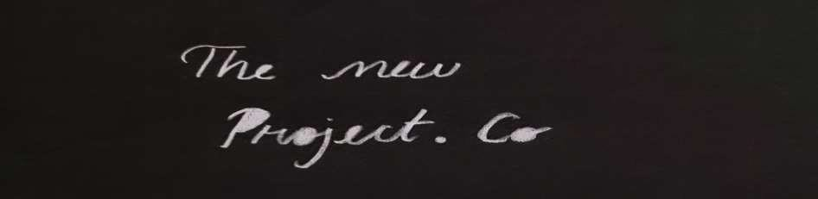
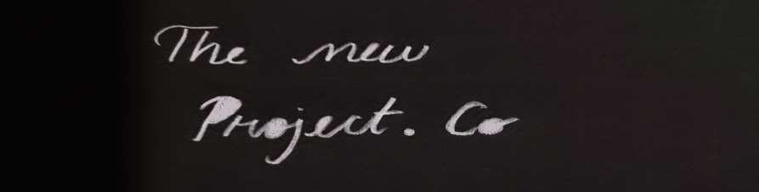
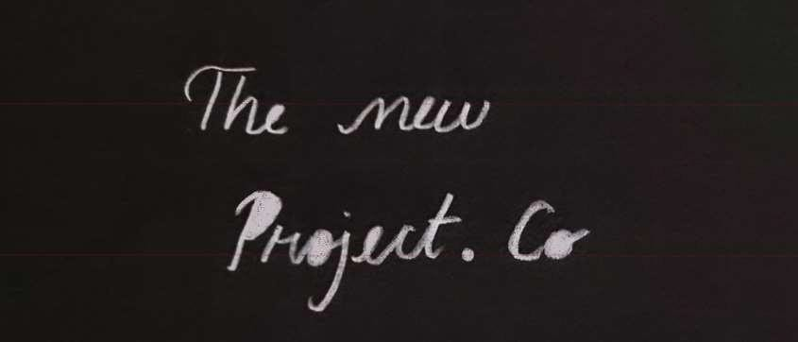
LABELLING:
IMAGE MORPHING:
BOUNDING BOX:

Slide 16
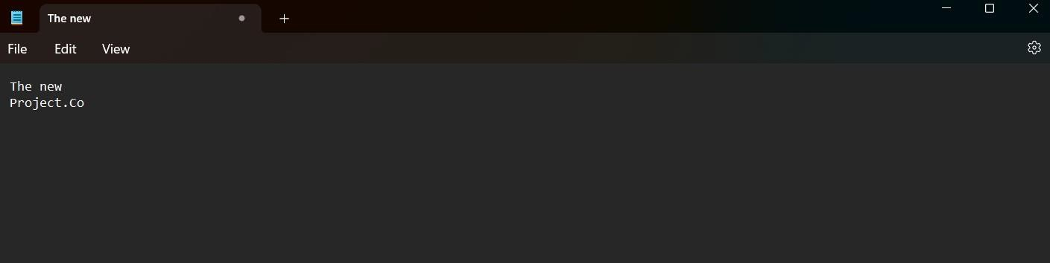
Final Output:

Slide 17
Outcome and future Scope:
By using the methods of characterization loci and SVM toolbox we were able to achieve an accuracy in the range of 60-70 % on untrained data for online character recognition which dramatically increased over 85% when the same data was trained into the database. The coding used for noise reduction was also successful and capable of removing stray marks on the sheet of paper being used as well as the other noises that came while taking the picture were also removed automatically.
Today’s uses of OCR are still somewhat limited to the scanning of the written word into useable computer text. The uses include word
processing, mail delivery system scanning, ticket reading, and other such tasks.
In the future, the uses of OCR have been speculated to be far more advanced. Some of these advancements are already in the workings. Most believe that the use for reading the written text will diminish as electronic data interchange (EDI) is used more and more, while paper documents are phased out.
However, a recent AIIM study found that imaging increased paper consumption because of increased printing. While the debate carries on, it
is clear that advancements will lead OCR to greater heights than before.
OCR is already used to detect viruses, or unfortunately create them, and to stop spammers. Anti- spamming applications continue to be improved, as the need for increased technology is a constant. OCR is used to prevent viruses by detecting codes hidden in images.
While the difficulty of transferring information from legacy systems to modern operating systems can be cumbersome, OCR is able to read screenshots. This can facilitate the transferring of information between incompatible technologies.
One of the current hopes for OCR is the chance of developing OCR software that can read compressed files. Text that is compressed into an image and saved as ASCII or Hexadecimal data could be read by OCR and transferred back into readable text.
Finally, it is anticipated that OCR will be used in the development of more advanced robotics. The eyes of a robot are essentially a camera
meant to input information. If OCR is used to help the robot comprehend text, the uses could be almost endless. All of these advancements and
more are expected to keep the technology of OCR in use and continue to expand its current capabilities.

